Slide 1
2023 Cyclistic Case Study
Analyzing similarities and differences between members and casual riders
By Sam Lee Herring

Slide 2
Questions we set out to answer:
What are the differences between the groups?
What are their similarities?
Is increased conversion a viable strategy?
Identifying key differences in customer behaviors is key to understanding the wants and needs of each.
Understanding the convergences in customer usage will help us not only to identify trends in usership, but also errors in app use.
Our initial goal is to increase conversion to full membership, but is this the best strategy? Exploring alternatives throughout analysis will give us our answer.

Slide 3
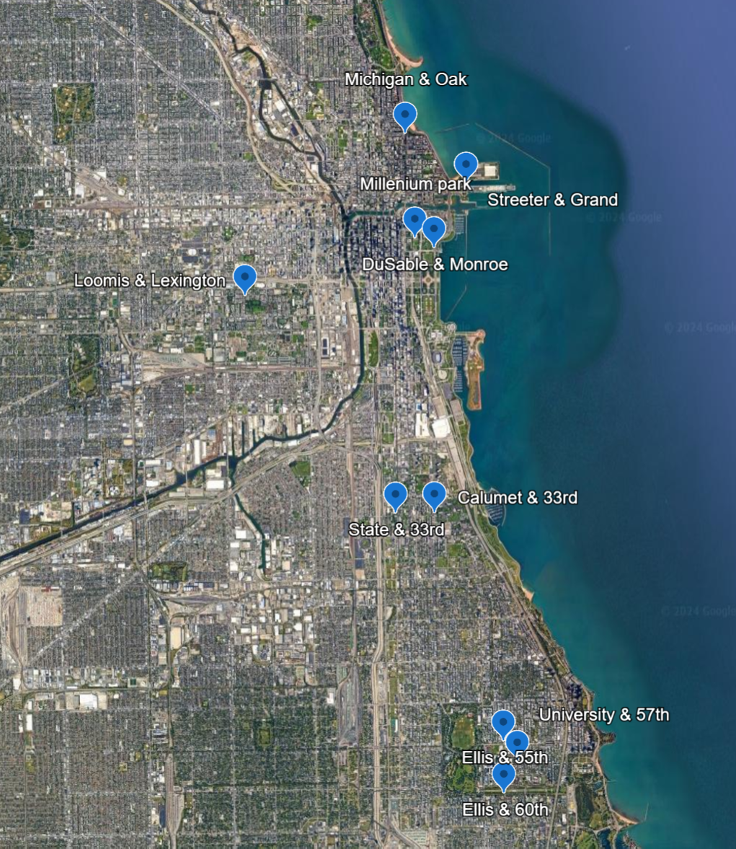
Initial processing
Understanding the raw data
Using the geographic coordinates to establish the maximum range of our operation, we’ve identified the top 10 hotspots.

Slide 4
The process:
Analysis
Contextualization
Recommendation
My team has been tasked with processing and analyzing the ridership data of 2023.
We were asked to identify trends between rider types in an effort to convert more users to members.
After establishing the background information and generating specified fields, we can see:
Significant outliers
How the groups vary
Concentrated user points
Move toward more qualitative data
Explore varied pricing options
Highlight the advantages of membership

Slide 5
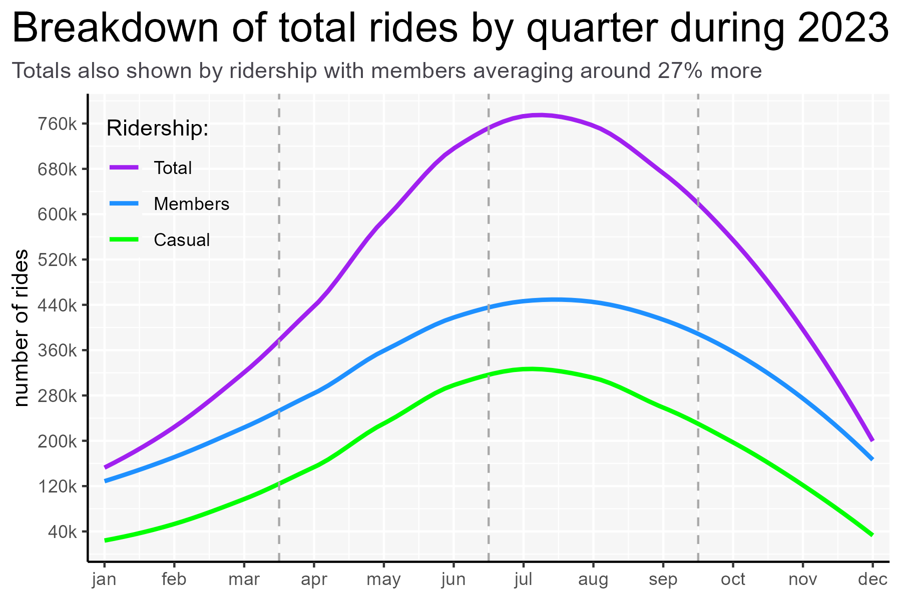
Initial findings:
After a lengthy processing stage, we’ve identified many similarities between members and casual riders.
Each rider type follows similar ride distribution along an annual scale.

Slide 6
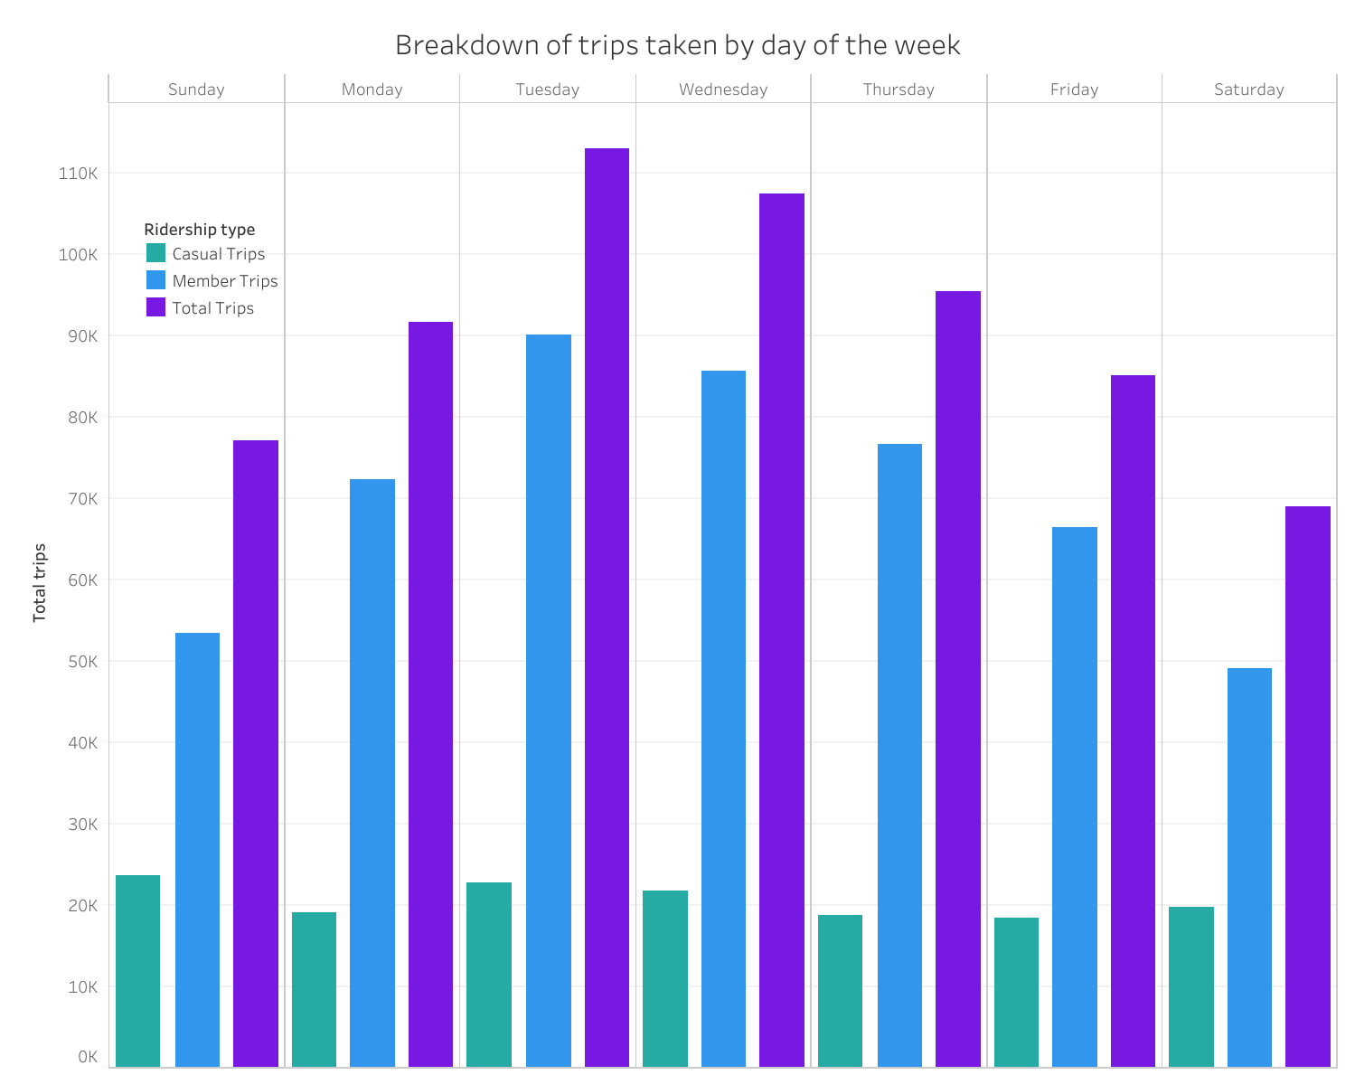
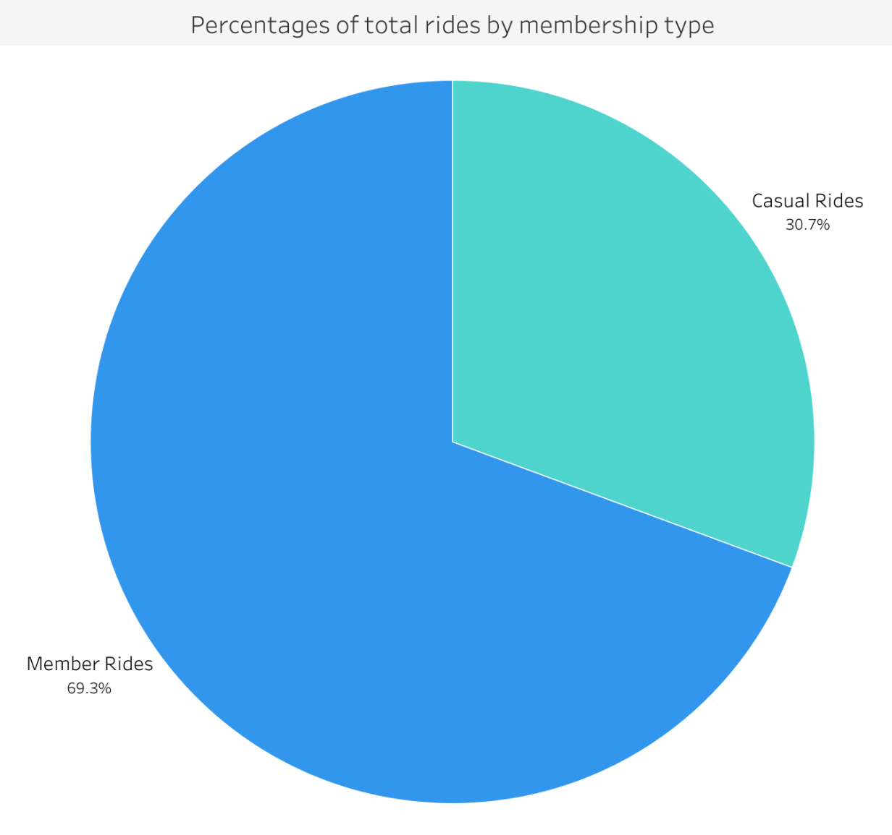
Initial findings (cont’d):
Patterns in ridership distribution remain largely the same throughout the month and week.

Slide 7
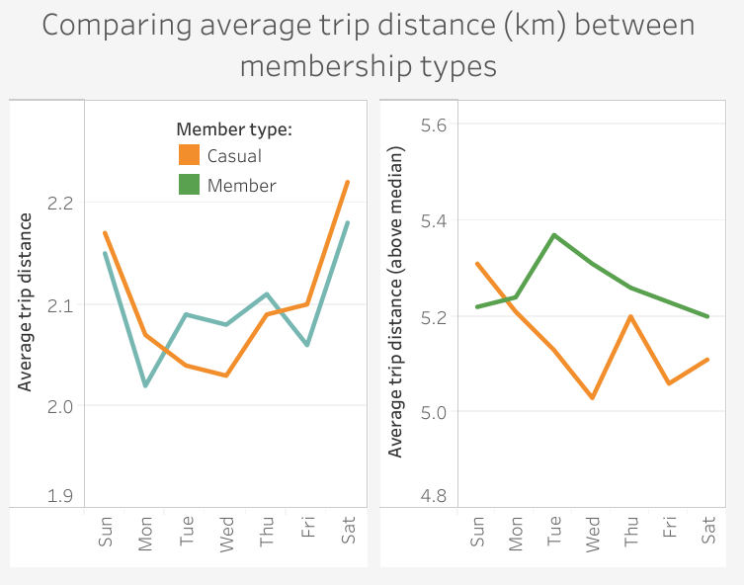
A deeper look
What can we extrapolate?
Identifying contrasts in behaviors is the first step to understanding how to craft an offer.
One of the main differences:
Average distance traveled by group

Slide 8
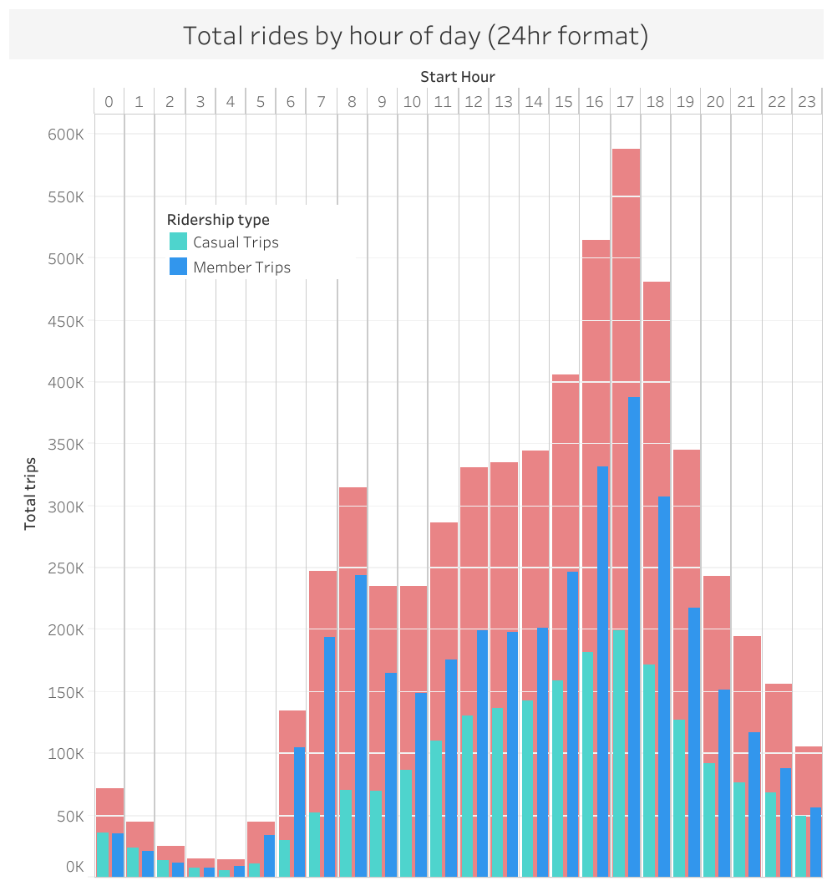
Further findings:
The two main differences between members and casual riders were:
How long/far each rode
What time of day they preferred
So what can we glean from this?
Notes:
Even though each followed the same curve, members far outnumbered casuals during business hours, and casuals just outnumbered members late night

Slide 9
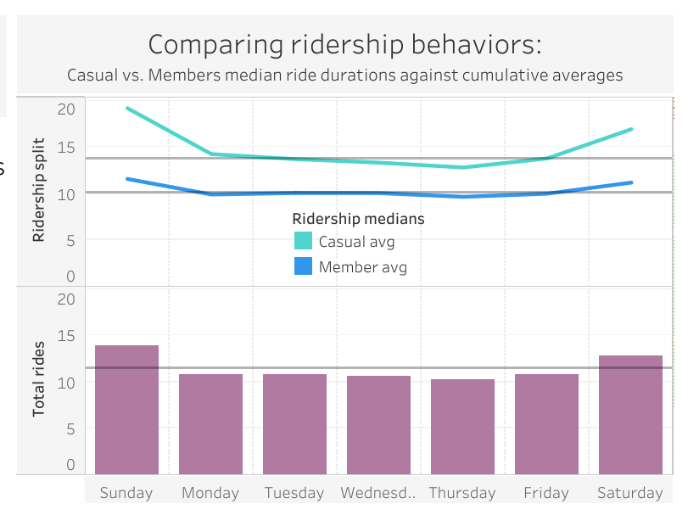
Conclusions
Each rider type is using Cyclistic as best suits them.
So how can we encourage more membership conversions if there’s not much difference in use?

Slide 10
Recommendations:
Move toward more qualitative data.
Explore alternative pricing models.
Highlight the advantages of membership.
max growth
Notes:
Customer surveys: Finding out who our customers are and why they use our app will help us better understand user demographics. This will allow us to better cater towards specific groups, which in turn will help to draw in more people in that area.
Alt pricing models: Once we understand their interests better, we may find that membership is just not that attractive of an offer. In this case, we should be open to looking to alternative pricing options.
Highlight membership: Highlighting the perks of membership within and outside of the app would be a good way to get riders to at least look into getting a membership. Maybe members' top stations and locations are always stocked during surge times during the day, or maybe they have access to an exclusive bike model that's faster or more comfortable.

